Slide 1
MIKE 11
Floodplain Modelling and Quasi 2D

Slide 2
FLOODPLAIN MODELLING
Floodplain Modelling Options:
1D:
Lump River and Floodplain as Single branch
Simple 1D River Model in MIKE 11
Branched and Looped Network in MIKE 11
Floodplain as part of the cross-section in MIKE 11
Floodplain computed as additional storage in cross-sections in MIKE 11
Limitation: Same Water Levels in River and Floodplain
Quasi 2D:
River and Floodplain separate Flow Paths
Requires accurate and detailed Data
Relevant for:
Flood Mapping
Floodplain Inundation and Drainage Modelling
Flood Damage assessments

Slide 3
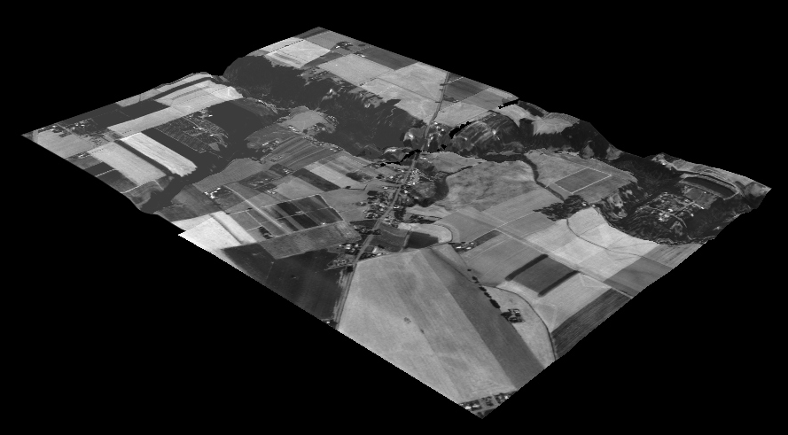
FLOODPLAIN MODELLING
Looped and Quasi-2D Networks

Slide 4
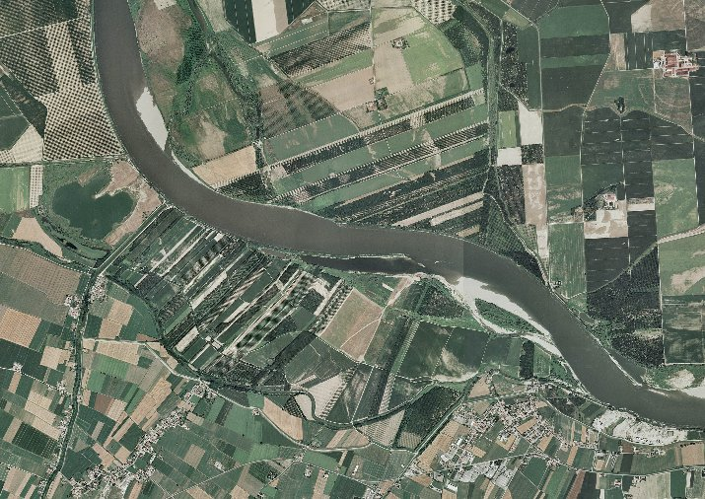
FLOODPLAIN MODELLING
Simple 1D River Model
SIMPLE 1-D RIVER MODEL
RIVER CROSS-SECTIONS
RIVER CROSS-SECTIONS
RIVER CROSS-SECTIONS

Slide 5
FLOODPLAIN MODELLING
Branched and Looped Network
GREATER SCHEMATISATION (1D)
LOOPED RIVER NETWORK
TRIBUTARIES

Slide 6
FLOODPLAIN MODELLING
Floodplain Model (Quasi 2D)
FLOODPLAIN MODEL (QUASI 2-D)
FLOODED AREAS
LINK CHANNELS
PARALLEL RIVERS

Slide 7
FLOODPLAIN MODELLING
Schematisation (One-Dimension)

Slide 8
FLOODPLAIN MODELLING
Schematisation of Floodplains (Quasi 2D)

Slide 9
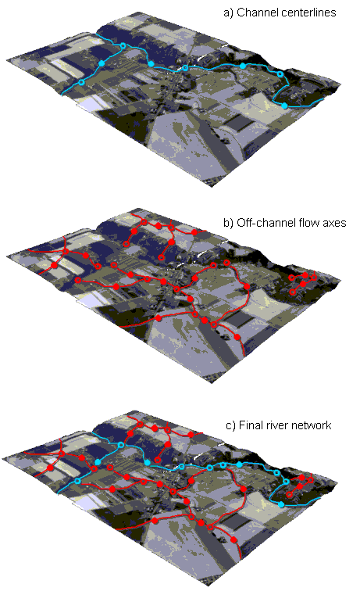
FLOODPLAIN MODELLING
Inundation Flow Network

Slide 10
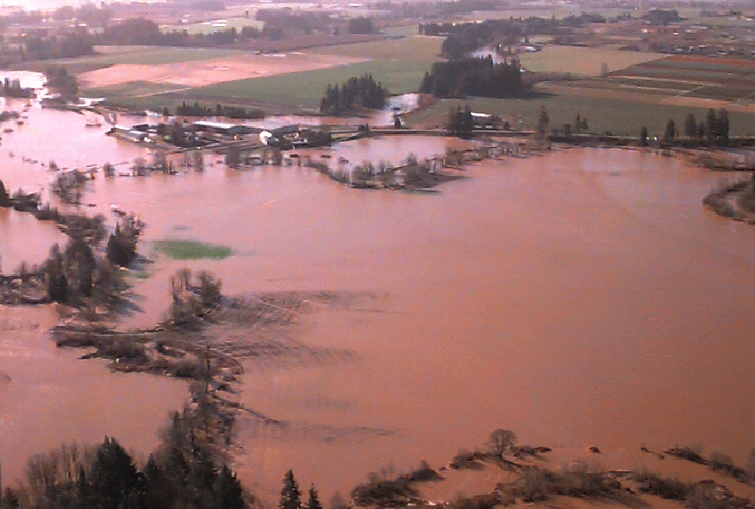
FLOODPLAIN MODELLING
Integrated Flood Plain

Slide 11
FLOODPLAIN MODELLING
N
Flood plain model not needed
START:
Does the river spill?
Y
Do the spill areas convey
significant flow discharges ?
N
Are levees present ?
Y
N
Y
Flood Cell with
link channel
Additional
Flooded
Area
Are spill flows conveyed
parallel to the river ?
N
Y
Flood plain
attached to
cross section
Are levees present ?
N
1D
Y
Is the flood plain flow frequently
interrupted by roads and other
flow obstructions?
Y
N
Q 2D
Interlinked Flood Cells
Routing Channels

Slide 12
FLOODPLAIN MODELLING
Differences Between 1D and Quasi 2D
1D:
Channel and Floodplain lumped together in Single Cross-Section
One Water Level and Velocity Applies to both Channel and Floodplain
Quasi 2D:
River and Floodplain Separate Flow Paths
Requires Accurate and Detailed Data
Relevant for:
Floodplain Inundation and Drainage Modelling
Flood Mapping and Damage Assessments

Slide 13
FLOODPLAIN MODELLING
Floodplain Schematisation Options
FP1: Ignored
FP2: Added Storage
River
Floodplain ?
River
Floodplain
FP3: Part of the Cross-Section
FP4: Separated from the River
River
Floodplain
River
Floodplain
Link channel

Slide 14
FLOODPLAIN MODELLING
Floodplain Schematisation Options
?
?
FP1 :
FP2 :
FP3 :
FP4 :
•
•

Slide 15
FLOODPLAIN MODELLING
FP2: Added Storage
Used to Account for Areas in the Floodplain that will affect Water Levels in the Main Channel
Applied Through Processed Data Tables as Area At Different Levels

Slide 16
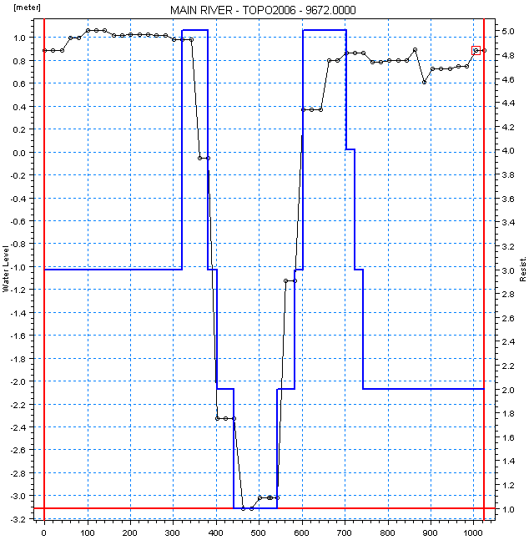
FLOODPLAIN MODELLING
FP3: Part of the Cross-Section
Floodplain Geometry can be Assigned Different Resistance Values to Reduce Conveyance
Applied Through Raw Data Tables as Roughness or Factor

Slide 17
FLOODPLAIN MODELLING
FP4: Separated from the River
River Channel and Floodplains Modelled Separately
Link Channels Define Flow Exchange between Branches
Link Channels have no Storage and behave like Weirs
Floodplain
Connection to
River Branch
U/S Bed Level
D/S Chainage
Link Structure
Manning's Coefficient
River
U/S Chainage
D/S Bed Level
Connection to
Floodplain Cell
or Branch

Slide 18
FLOODPLAIN MODELLING
Floodplain Inundation
High ground
River
No Flooding: FL1 : Local Rainfall Flooding FL2 : Flooding via local depressions FL3 : Flooding via Levees
No Flooding
FL1
FL2
FL3

Slide 19
FLOODPLAIN MODELLING
Floodplain Inundation
DR1 : Drainage via Channel DR2 : Drainage via Levees
River
Flood Plain
Channels
DR1
River
Flood Plain
Levee
DR2

Slide 20
FLOODPLAIN MODELLING
Duplicate Storage at Junctions
In Complex Networks there is Potential for Duplicate Storage at Junctions
Schematisation might need to be Adjusted
Use Link Channels which have no Storage

Slide 21
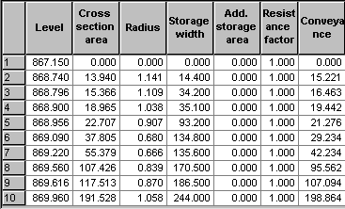
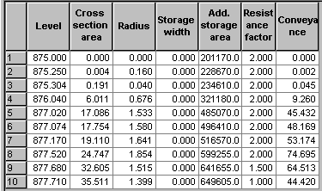
FLOODPLAIN MODELLING
Model Storage:
Calculated from Cross Section Width:
User Defined Storage:
Total Surface Storage = Storage width*dx + Add. Storage
dx
1
/2
dx
2
/2
b
1
b
2
b
3
A
s
=b
2
(dx
1
/2+dx
2
/2)
dx
1
dx
2

Slide 22
FLOODPLAIN MODELLING
Schematisation of Junctions
Ensure that the Lowest Point of each Cross-Section is a Similar Level
If Bed Levels are Significantly Different, use Link Channels to Connect
River 1
River 2
River 3

